Slide 1

A Survey on Machine Learning Techniques for Airbnb Price Prediction
STAT 493: Senior Seminar Project
By: Kevil Khadka

Slide 2
Introduction
Airbnb is a vastly growing and a trusted community online marketplace.
It connects travelers with local homeowners.
. Since the company started in 2008, it has now over 150 million total users,
more than 2 million of people staying in an Airbnb per night,
Over 6 million of global Airbnb listings worldwide,
35-billion-dollar valuation based on recent stock sale
Growth rate: 45% increase in United States bookings year-to-year
: 153% global compound growth rate since 2009
(source: Airbnb-statistics)

Slide 3
Problems
What can we learn from the dataset?
What variables are important to predict the price?
Which machine learning techniques are the best to predict the price?
Comparing the accuracy of each model
Finding out the least Test MSE among models
Text Mining and Sentiment Analysis of review dataset of six major cities:
LA, Chicago, New York, Boston, London, and Greater Manchester

Slide 4
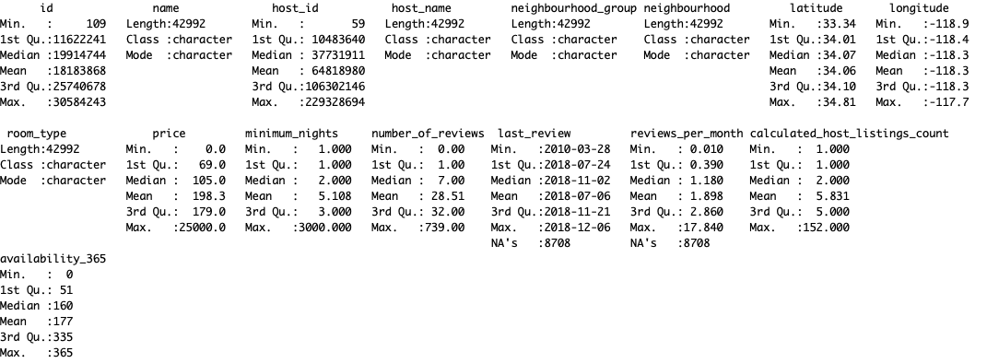
Summary of Listings Dataset of LA
16 Variables and 42,992 Observations

Slide 5
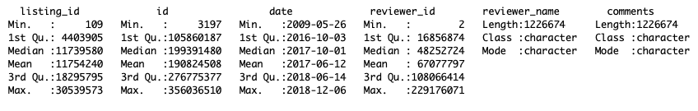
Summary of Review Dataset of LA
6 Variables and 1,226,674 Observations

Slide 6
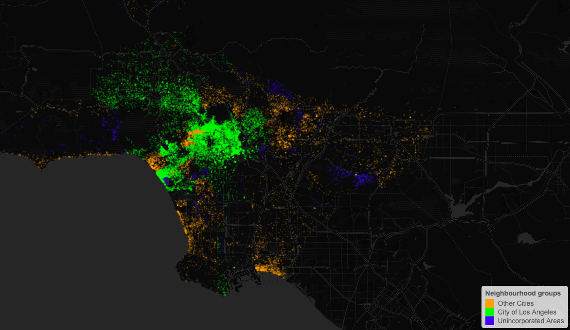
Neighborhood groups
City of LA: 29, 358 | Other Cities: 11, 396. | Unincorporated Area: 2238
Using Leaflet map

Slide 7
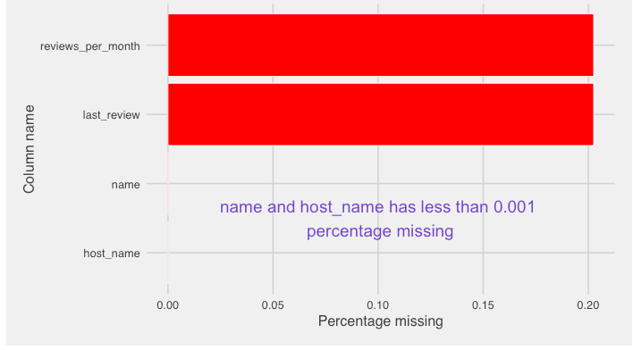
Missing Dataset

Slide 8
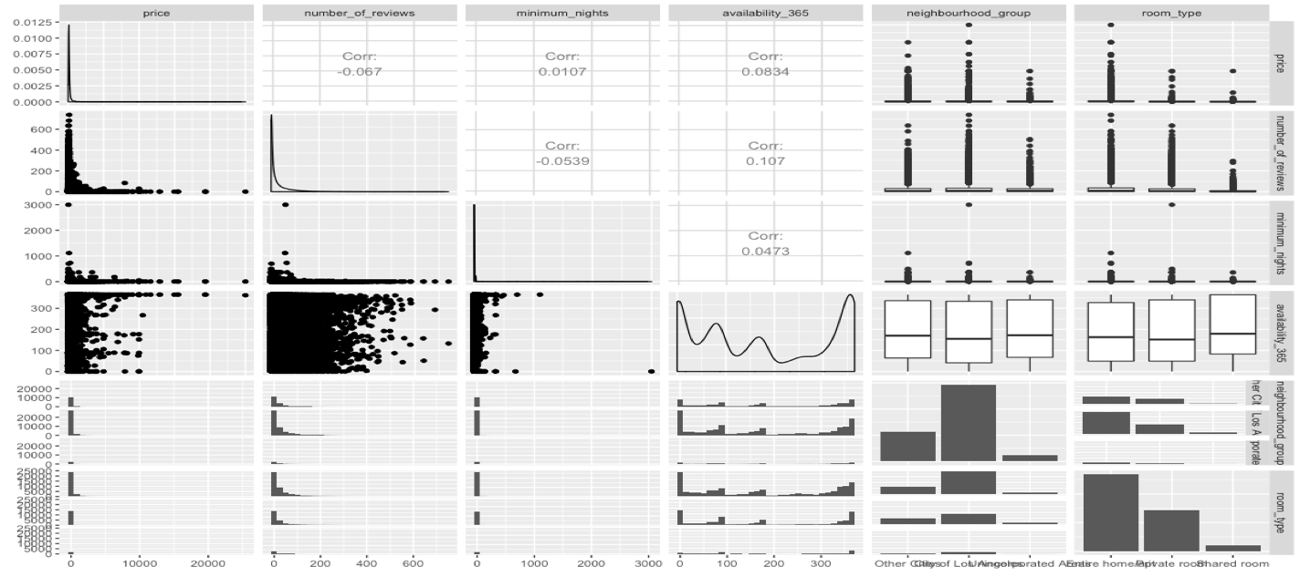
Scatterplot Matrix

Slide 9
Changes in variables
Removed all null values
Price > 0 and log transformation
Minimum nights (1 to 31) and sqrt transformation
Availability of range (1 to 365)
Price into categorical variable: 3 levels (Low, Medium, High)
Number_of_reviews into categorical variable: 3 levels (LR, MR, HR)
Reviews_per_month into categorical variable: 3 levels (LRM, MRM, HRM)
Review datasets limited to 1000 observations only

Slide 10
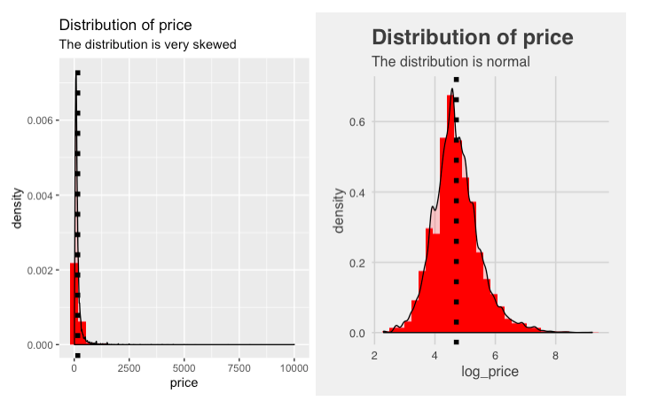
Price: Response Variable

Slide 11
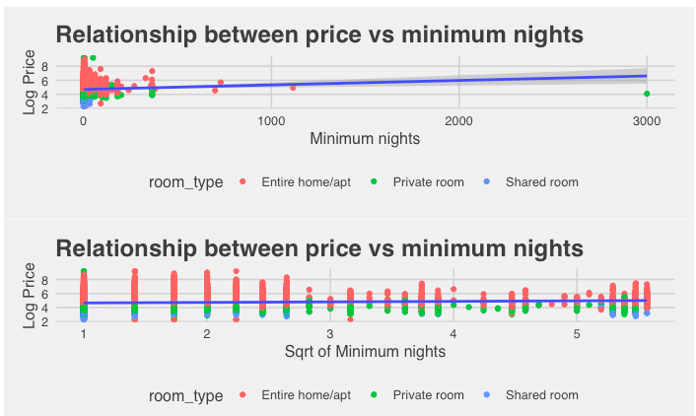
Tourists usually like to book entire home/apartment
Shared rooms are mostly unpopular
Majority of people stay at least one week in Airbnb rental home

Slide 12
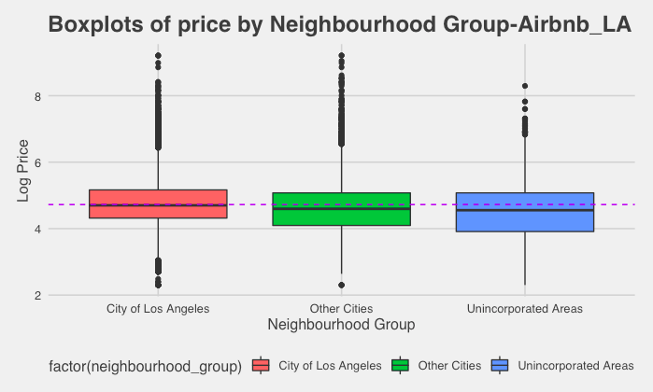
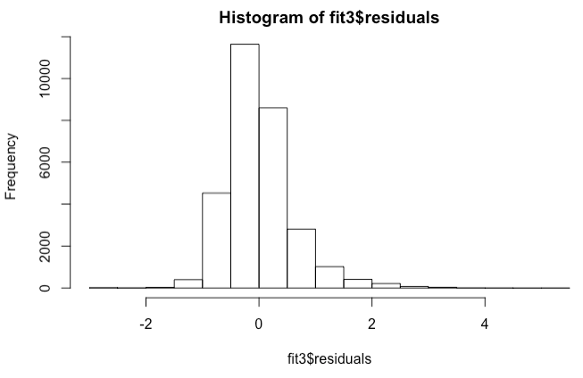
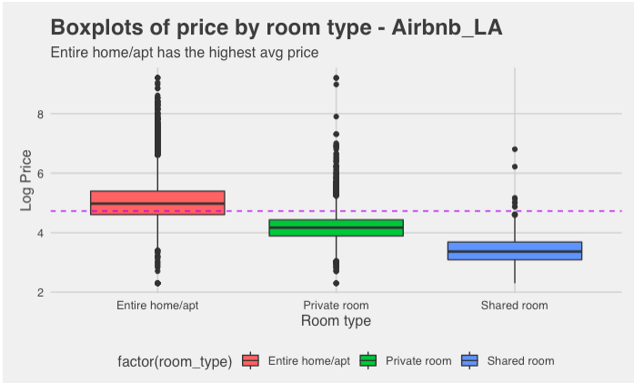
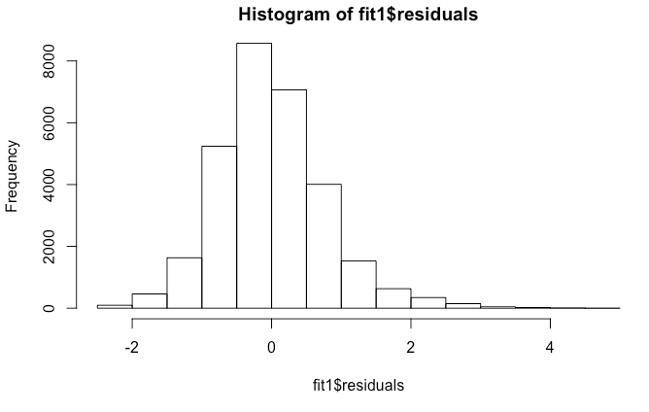

Slide 13
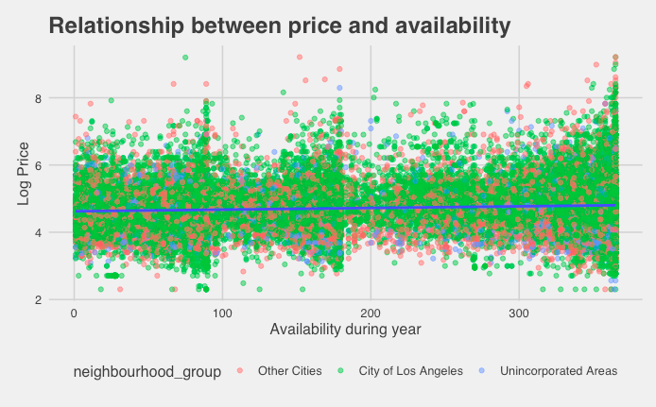

Slide 14
Machine Learning
Split the dataset into train/test (70:30)
Run the Forward Backward Elimination Method to find the best predictor variables
The Reduced Model
log_price ~ neighbourhood_group + room_type + availability_365 + sqrt.min.nights + num.review.level + review.per.month + host.list.count
Fit the Multiple Linear Regression Model:
Multiple R-Squared of Reduced Model of Train Set = 0.4477
Adjusted R-Squared of Reduced Model of Train Set = 0.4474
MSE of Reduced Model of Train Set = 0.3330
Test MSE: 0.3387

Slide 15
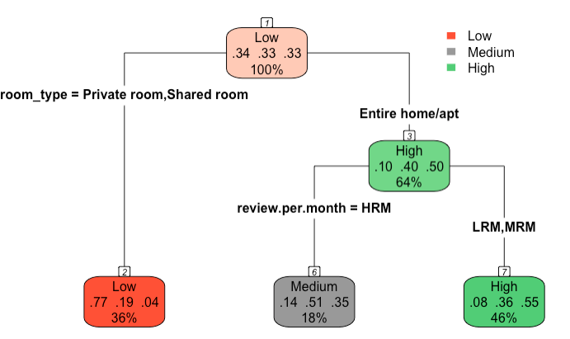
Decision Tree
fit.DT <- rpart (price_group ~ neighbourhood_group + room_type + sqrt.min.nights + num.review.level + availability_365 + review.per.month, data = la.train.DT)
Accuracy : 0.6247
Test MSE: 0.3752533
Variable importance:
room_type: = 89
review.per.month = 5
availability_365 = 5
num.review.level = 1

Slide 16
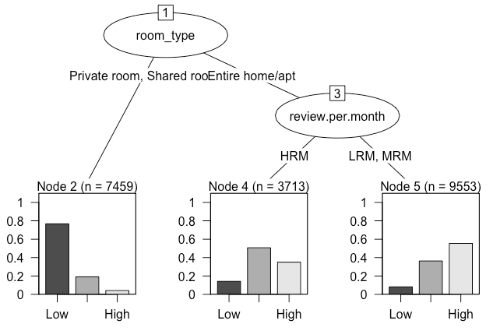
Decision Tree: Alternative Plot
# Using Party Package
Naïve Bayes
# Using Caret Package
la.naive.model <- train(x = la.train.DT[-5],
y = la.train.DT$price_group,
'nb',
trControl = trainControl(method = 'cv', number = 10))
Test Accuracy : 0.6336
Test MSE: 0.3663

Slide 17
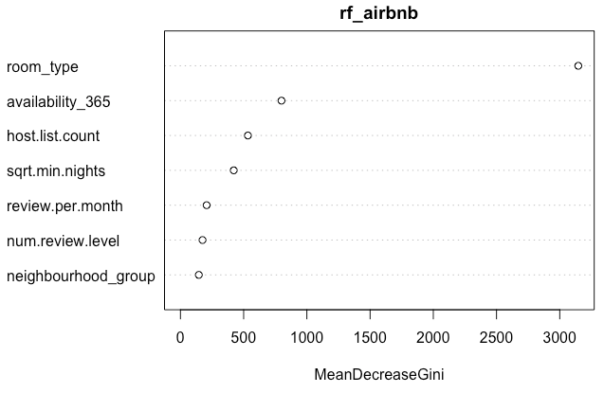
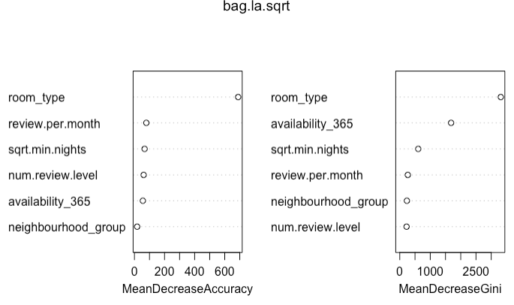
Random Tree
Accuracy : 0.6459
Test MSE: 0.3540869
OOB estimate of error rate: 35.8%
Variable importance:
room_type:
Availability_365
Bagging
# Using mtry = sqrt(7)
Accuracy : 0.6312
Test MSE: 0.3688358
OOB estimate of error rate: 37.42%
Variable importance:
- room_type
- Availability_365

Slide 18
Linear Discriminant Analysis (LDA)
Prior probabilities of groups:
Low Medium High
0.3392521 0.3272376 0.3335103
Test Accuracy : 0.6273
Test MSE: 0.3726638
Quadratic Discriminant Analysis (QDA)
Prior probabilities of groups:
Low Medium High
0.3392521 0.3272376 0.3335103
Test Accuracy : 0.5159
Test MSE: 0.4841252
k Nearest Neighbour (kNN) #k =8
Test Accuracy : 0.5383
Test MSE: 0.4617203

Slide 19
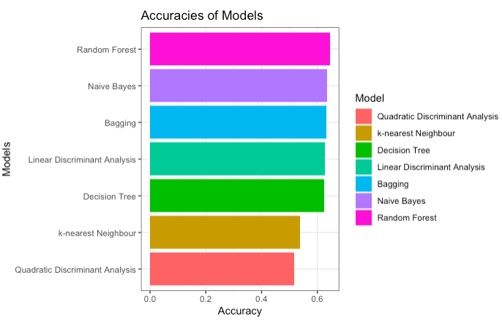
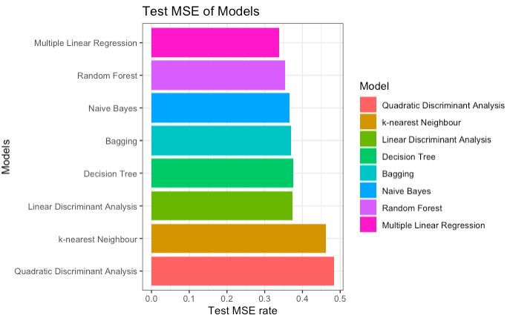
Comparing Test MSE
Accuracies Performance Comparison

Slide 20
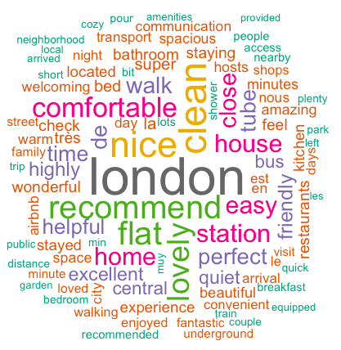
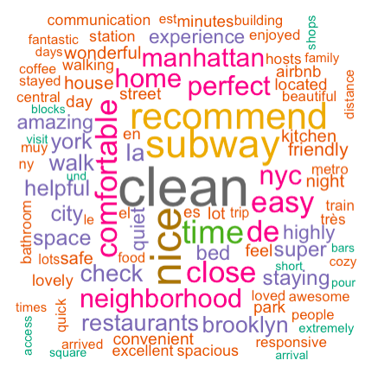
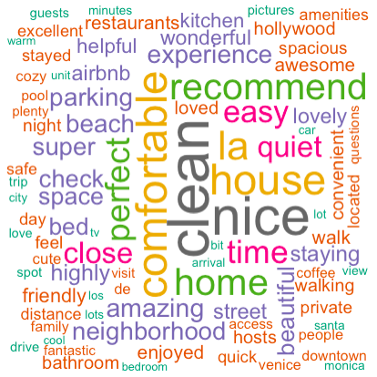
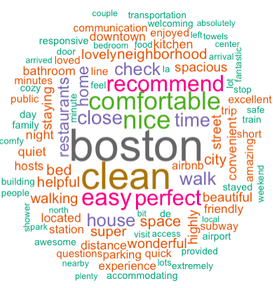
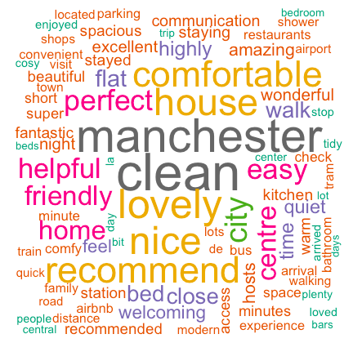
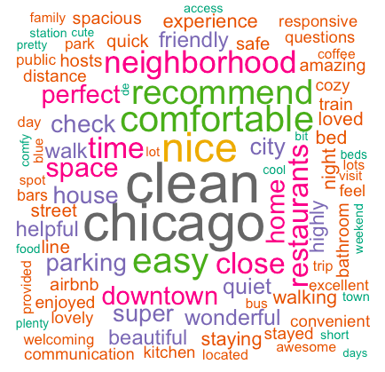
Text Mining
Unigram Model: It selects the most eye-catching single word from the review dataset.
# tidytext package

Slide 21
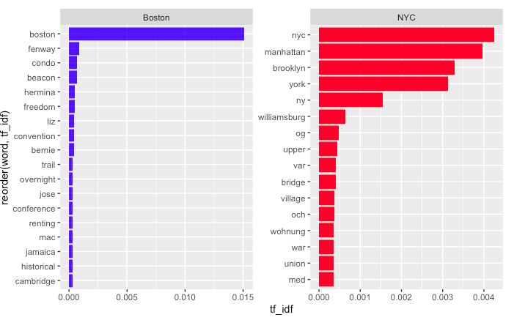
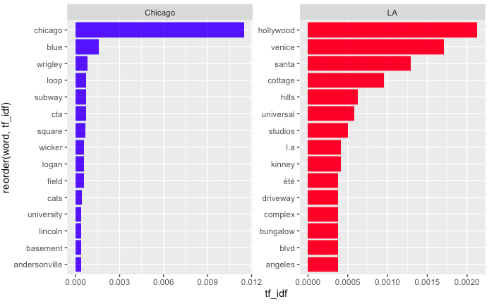
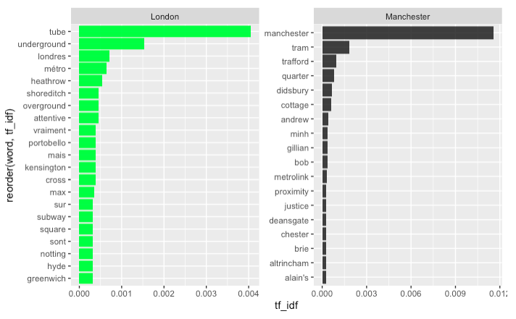
Term frequency-inverse document frequency (tf - idf) finds out how important a word or comment is to a document or in a collection of documents, which focuses the difference between the reviews of the two cities.
- Words in the document with a high tf-idf score occur frequently in the document and provide the most information about that specific document.

Slide 22
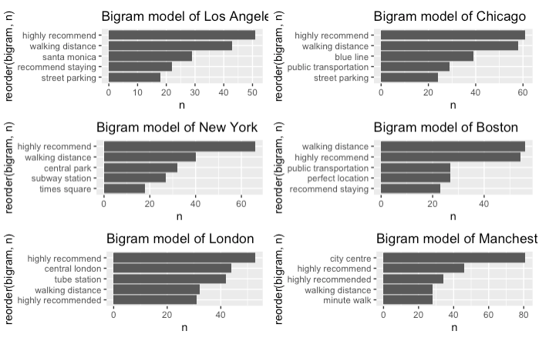
Bigram Model

Slide 23
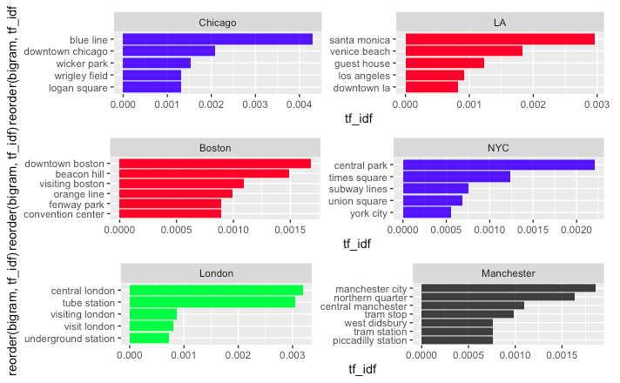
tf-idf score of bigram model

Slide 24
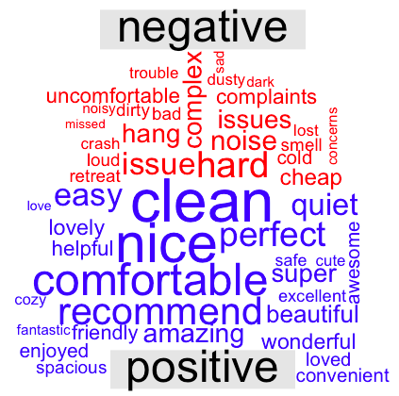
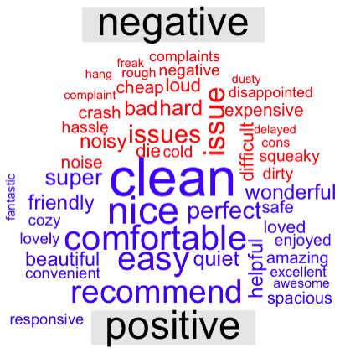
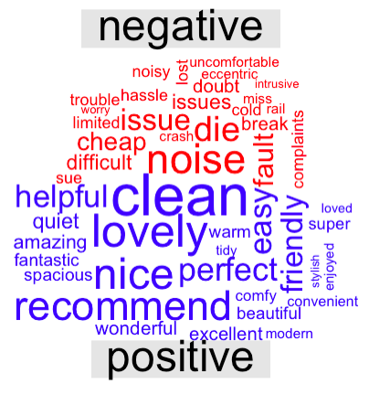
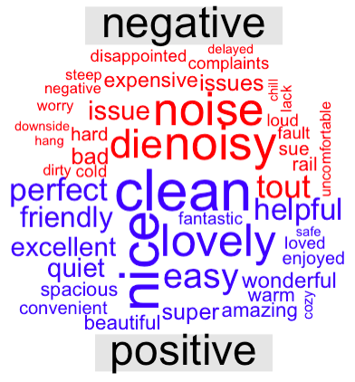
Sentiment Analysis
"Sentiment analysis is one of the most obvious things we can do with unlabeled text data (with no score or no rating) to extract some insights out of it. One of the most primitive sentiment analysis is to perform a simple dictionary lookup and calculate a final composite score based on the number of occurrences of positive and negative words.”
# Using ”bing” lexicon – with positive/negative annotations
Los Angeles
Chicago
London
Manchester

Slide 25
Future Works
Continue work on kNN model. If not, will probably choose Radial Basis Function (RBF).
I tried using google cloud computing but did not go well. Learn more about cloud computing to work on big data.
Add new methods like GAM (Generalized Additive Model) and Neural Networks.
Conclusion
Best ML method to predict the response: Random Forest
Important variables: ”room_type”, “availability_365”
Text and sentiment analysis are a good ways to understand consumers choice
The reviews seem similar across different cities
It seems many tourists leave positive reviews and use similar positive words to describe their Airbnb experience.
It might be difficult to conclude which city has a higher Airbnb rating since most of the reviews are positive and similar.

Slide 26
Data Source:
Airbnb Listing and Review Dataset: insideairbnb.com
Airbnb-Statistics. ipropertymanagement.com/research/airbnb-statistics
Tidytext Mining in R. https://www.tidytextmining.com/sentiment.html.

